Slide 1

Presented by:
iMedia Ad Agency
[M] +91 7310639456
[E] imediainfotech@gmail.com
[W] www.logo-company.in, www.kickstartwebsite.com

Slide 2

What if your customers are not able to find you online ?
One simple questions however can give you nightmares.
Millions of people everyday use search engines to find products and services, if they are not able to reach you then you are missing out on a lot of sales and revenue.

Slide 3
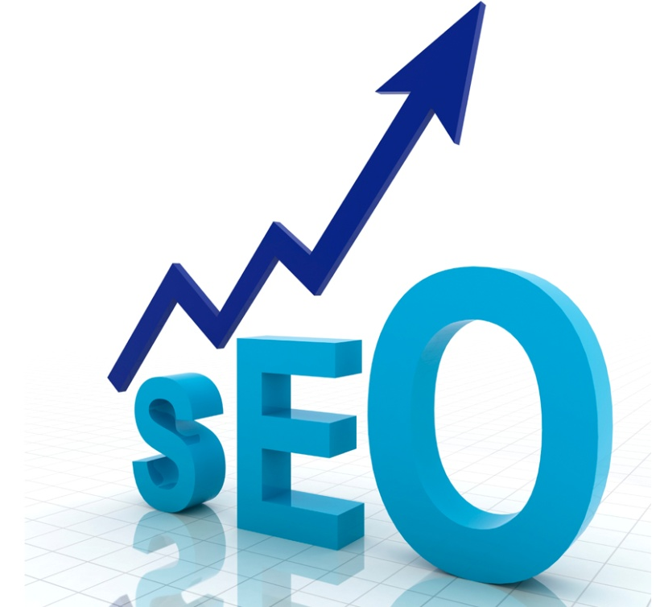
SEARCH ENGINE OPTIMIZATION
– THE MOOLMANTRA
Search Engine Optimization is basically a strategy to rank websites high on search engines.
Search Engine Optimization is also referred to as Internet Marketing, Internet Promotion, Search Engine Ranking, Search Engine Promotion, Search Engine Submission, Online Marketing, Online Advertising etc
However, the basis aim of all of them is to achieve high ranking on SERP's [Search Engine Result Pages / Organic Listing]

Slide 4
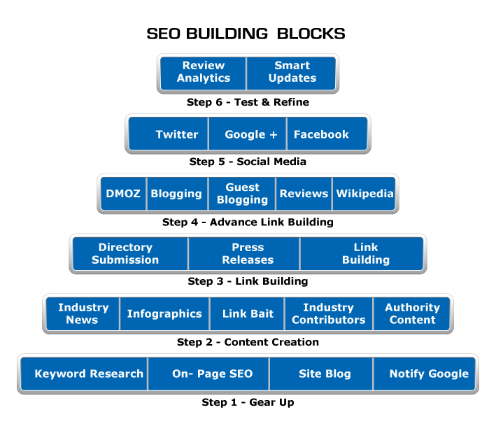

Slide 5

DO YOU REALLY NEED A SEO EXPERT ?
- YES
If you website is not ranking higher.
If there are not enough visitors to your website
If your customers are not able to find you
If you are not driving enough sales from your website
If your competitors online presence is going up & yours down
If you are really serious about rankings and sales, it is advisable to hire SEO Consultant.

Slide 6
BENEFITS OF SEO IS AS UNDER:
SEO increases the number of visitors who are looking for your product or service, ie more and more Customers
A promotion that never sleeps
Increase your visibility
High return on investment
Higher sales - SEO has a proven record of improving sales figures
Improve your website’s performance
Definite Increase in Traffic
Higher Brand Credibility, People Trust Google
Better ROI (Return on Investment) Than Normal Ads
Your Competitors Are Doing It
The Results are Permanent
Unlike other traditional advertisements the affects of SEO are permanent. They don’t suddenly stop if you stop paying for them. Of course you will need a upkeep to maintain that top 1st spot ranking, but if you can get that top spot it retains for many months.

Slide 7
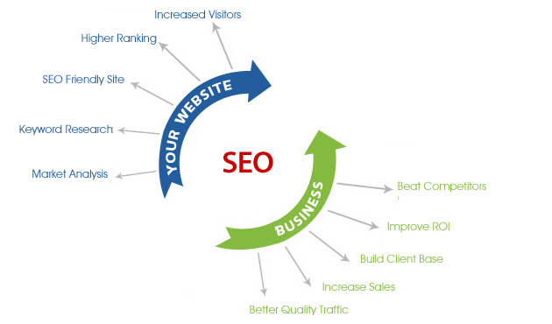

Slide 8
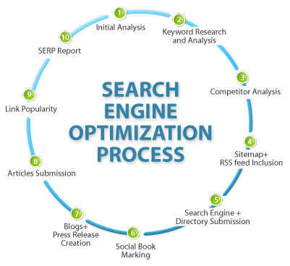

Slide 9
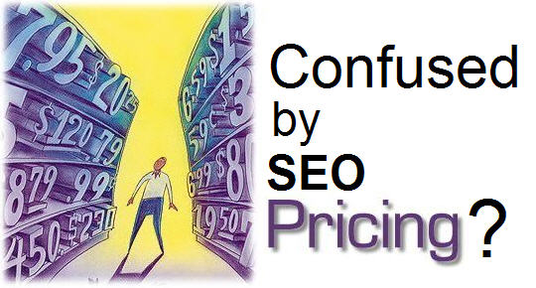
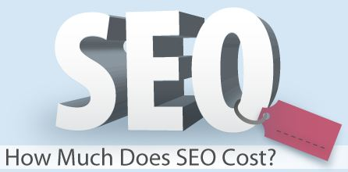

Slide 10
HOW MUCH DOES SEO COST?
This is a big question and confusing as well. According to me the Cost of Positioning Higher depends on HOW HARD THE KEYWORDS ARE AND HOW BAD IS YOUR COMPETITION.
SEO Cost depends mainly upon:
If you have a new websites, websites below 6 months domain age are tough to rank.
If you are targeting keywords [ Local / National / Global Keywords]
The number of Keywords you want to rank on
How aggressively others have promoted on those keywords
How much SEO effort has already put into the website, websites already ranking at some places is easier to rank earlier within the top results.

Slide 11
HOW LONG DOES SEO TAKE?
The time required to rank the website depends on:
Competition of the Keywords:
For local keywords like SEO Company Delhi it might take 6 months for nationwide keywords like SEO Company India it might take 12 months. For local keywords you are only competing with local companies so the competition is less as compare to companies across India.
Present State of Website:
What is the present ranking of the site? If the site is already ranking within the Top 50 results it would take less time to push the ranking within the Top 10 results as compared to if the site is not visible on search engines or ranking very low.
Competitors SEO Effort:
What is the amount of effort the competitors have put in to the rank themselves? It is basically a competitor analysis. The more effort they have put in to rank themselves the more time and effort it would take to bring them down.

Slide 12
How long does SEO take ? – Page 2
Domain Age:
How old is your Domain Name. New Domain names take a little longer than usual to rank as search engines take time to crawl & index the site.
Number of Back Links:
If you have some good back links already pointing to the site it would take less time to rank the site. If not then we would have to build links from scratch.
Pages Indexed:
The more pages indexed the better it is as you can target more keywords on the site. More Pages also help to increase the density of the keywords on the site.
SEO is an On Going Process:
Once the rankings are achieved you still need to keep working on the site so that you stay ahead of the competition otherwise your sites ranking would drop or the competitors would be ranked ahead of you.

Slide 13
HOW IMEDIA WORKS ?
The elements of our “3-step” approach are:
Step 1 - Analysis
Step 2 - Proposal
Next we prepare a details proposal statement which includes the following:
  Current on-page and off-page status of your site
  On-page and off-page compatibility suggestions
  Detailed market / competitor analysis
  Monthly financial breakdown
  Off-page optimization strategy
  Payment terms and conditions
Step 3 - Path to Completion

Slide 14
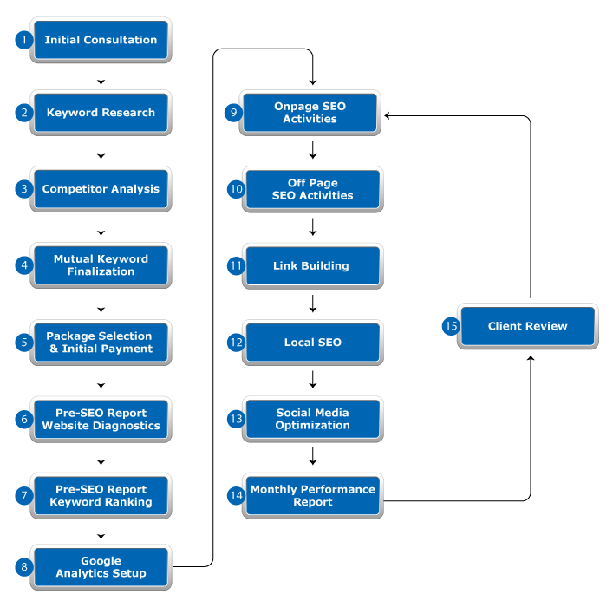

Slide 15
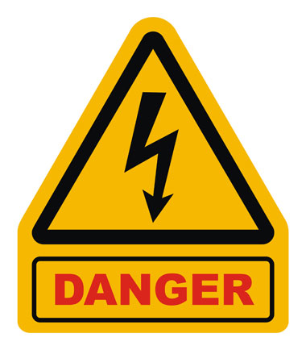
DO NOT:
Put all effort in 1 month as this would black list the website.
Go slow and steady and see the results yourself. Don’t expect results from the first month itself. SEO Takes Time, Search Engines Take Time to crawl, index and rank websites.
Break down the effort over 6 - 12 months period depending on the competition of the keywords. Every month when you add pages / write articles and build links, search engines will crawl them and keep improving your ranking.

Slide 16
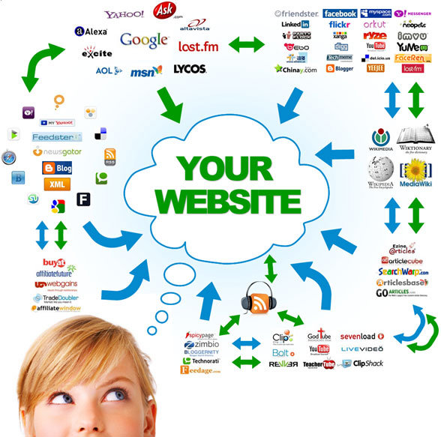

Slide 17

iMedia SEO / SMO SERVICE LIST
Onpage / Offpage SEO
Social Media Management
Link Building
Local Maps / Listings
Email Campaigns
Blog / Directory / Classified Submission
Internet Reputation Management
Facebook Advertising Campaigns
Google PPC Adwords Advertising
Online Travel Agency (OTA) Listing Setup

Slide 18
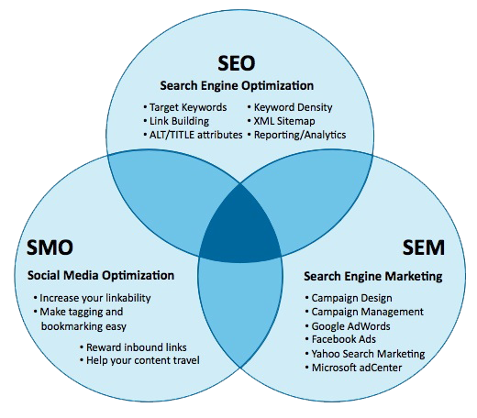

Slide 19
What is SMO?
Social Media Optimization (or SMO aka Social SEO) is essentially a promotions technique that uses social media activities to increase website traffic. The technique employs social networks and other web communities, rather than search engines, to enhance website visibility. SMO is divided into two sub categories, which are as under:
• Social Linking:
Addition of social media elements like RSS feeds, Social network buttons, blogging, and third-party community functionalities like images and video sharing onto a website.
• Social Media Marketing:
Which involves the use of social networks and communities like Facebook, Google+, Twitter, Youtube etc along with blogs, Wikis or any other collective online marketing medium to enhance brand awareness and encourage customer interaction. Below is an intricately designed image highlighting the various elements of Social Media Marketing and the endless possibilities it offers for product/service promotion online.

Slide 20
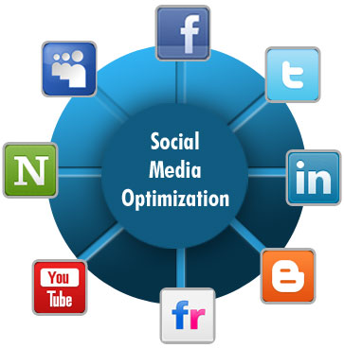
Online Brand Promotion & SMO
Nowadays business must use a variety of advertising media to successfully compete in the market. Mixing of older marketing media like television, radio, newspaper with newer media like the web and SMO is essential, especially in competitive arenas.
Our social media offerings include:
• Publishing
• Sharing
• Discussion
• Social Networking
• Microblogging
• Live Streaming
• Livecasting

Slide 21
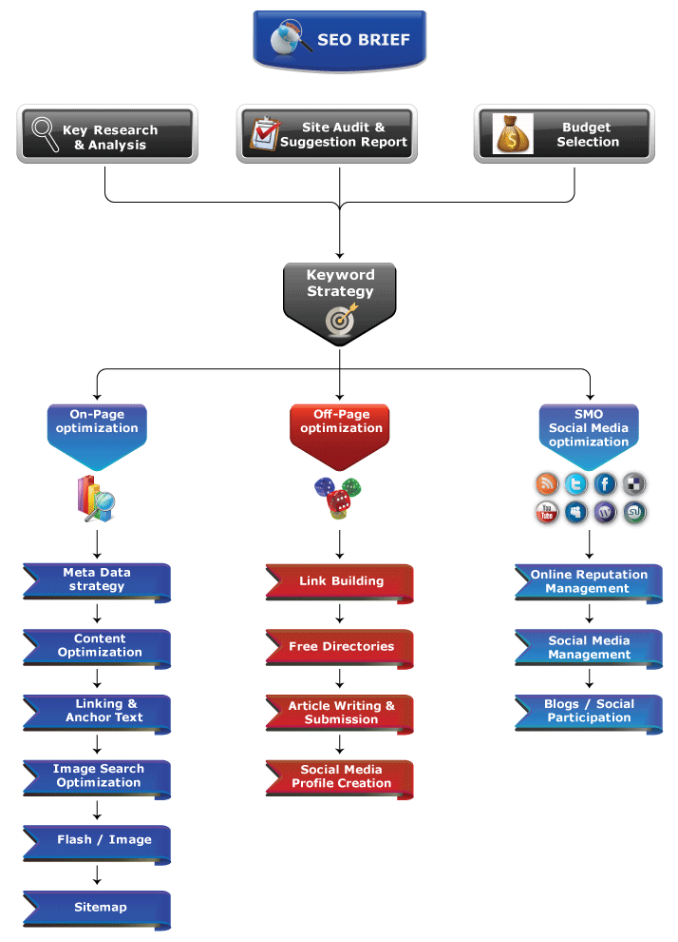

Slide 22
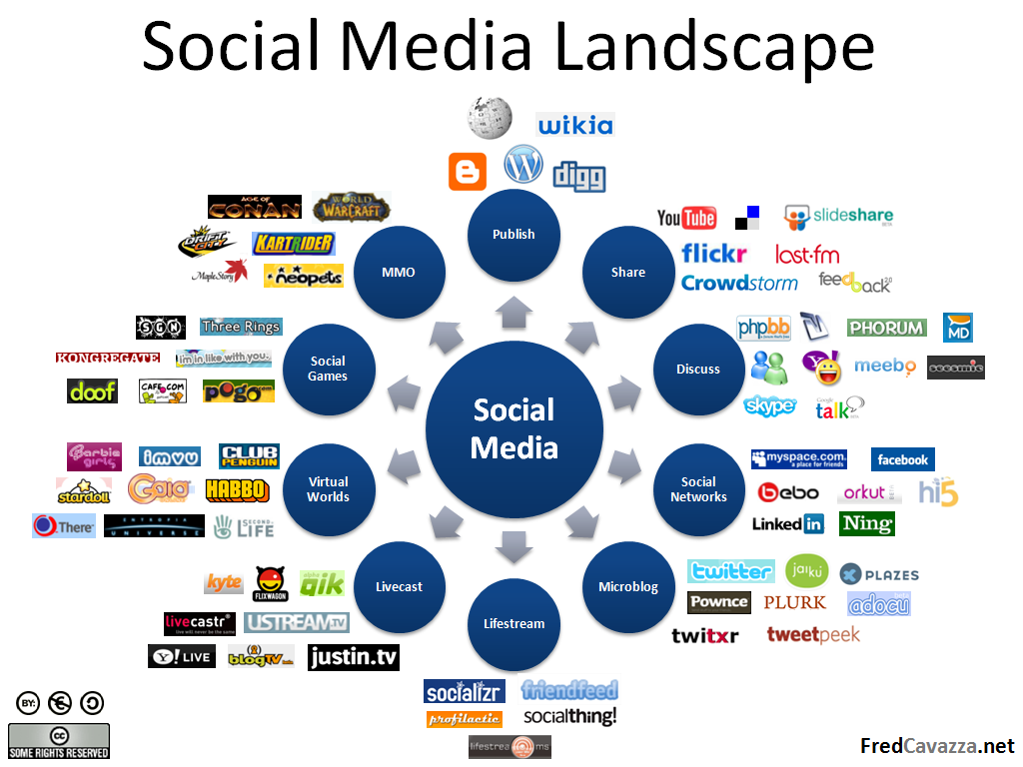

Slide 23


CONCLUSION
Reaching the Top of Search Engines, Getting Local Listing and Staying there is very crucial if you have an online store or generate business through Online Marketing.
Feel free to discuss WEBSITE SEO requirement…
Call “Sushant” or “Ms. Vijaya” at +91 - 9897493280
iMedia Ad Agency
[M] +91 7310639456
[E] imediainfotech@gmail.com
[W] www.logo-company.in, www.kickstartwebsite.com

